Slide 1
Modernism (1910-1930)
By AN

Slide 2
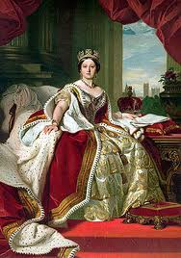
Modernism breaks with Victorianism
In Victorian society (1837 – 1901) literature had to be utilitarian. It had to serve a purpose → moral
Modernism doesn’t care! It emphasizes art for art’s sake - There are no authorities, neither king, queen nor a God!

Slide 3

Before Modernism (19th century)
E.g. genres of Realism, Naturalism, romanticism
began in the 1850s and sought to describe subjects as they really are - in an objective fashion
Positive approach to human beings and a constant positive development in the world
There’s sensibility and meaning in the world, God or just laws of nature → There’s a purpose to life → BIG YES-HAT
Harmony - positive outlook

Slide 4
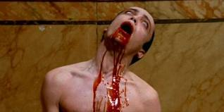
Build-up to modernism symbolism (1857-1900):
Language inadequate at presenting reality
Symbols should be used instead
Themes: the questioning of authority (e.g. God), primal lust, darkness, death, life as an artist, urban life, vampires, blood

Slide 5
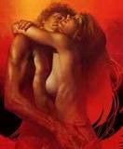
Build-up to modernism Freud (1856-1939)
introduces psychoanalysis which makes the subconscious mind and primal lust important topics.

Slide 6
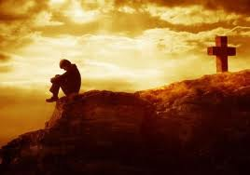
Build-up to modernism Nietzsche (1844-1900)
argues that man has killed God → there’s no longer any absolute meaning in life when God is gone. Religion is no longer a refuge because it is hollow.

Slide 7
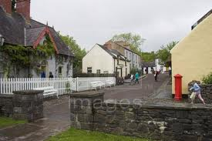
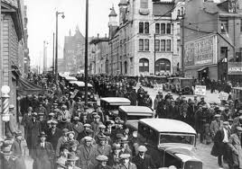
Build-up to modernism
Industrialization/urbanization ( 1st stage:1750-1850): fragments the world and causes a breakdown in traditional society/values.
            → → →
Einstein’s uncertainty principle (1905): shows that the world is unstable

Slide 8
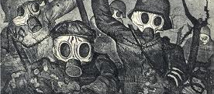
Build-up to modernism WW1 (1914-1918)
16 million dead and 21+ wounded
War in the trenches - People in despair

Slide 9
WW1
shows the meaninglessness of life/the world. A major breakthrough in Modernism.
Modernists couldn’t cope with society and turned their focus inward instead of outwards, which had been focus in the previous periods

Slide 10
Despair
focus inward → the main character can be a hero
but
when the real world is entangled that dream is shattered.
Early modernism was very pessimistic and negative
modernists tried to find beauty in ugly things → in a world that they thought was psychologically in ruins

Slide 11
Themes
feelings of being lost, alienated (→ the lost generation)
lust
good and evil
subconsciousness
the position of religion
paralysis → people are paralized because they are traumatized and trapped in an idealized past (alcoholism as a way to escape the past. E.g. Hemingway)
love → inability to feel love because of traumatisation – no one can bond
new way of seeing the past - painful, because it’s unattainable

Slide 12
In short:
When the world is fragmented, literature should also be fragmented, and there is no need for meaning because there is no meaning in the world / life.

Slide 13
Fragmented literature
no particular need for a plot or you may have a discontinuous plot.
New concept of time → It’s important what people think/feel during a certain period. The length of that period is not important.

Slide 14
Fragmented literature
Minimalistic style → you have to read between the lines. We’re given very little information and little description, called the iceberg theory. Less is more. You need to figure it out! (e.g. Carver’s Neighbours)
A tendency to break rules → a modern writer does what he wants to do. He is not bound by the rules of a genre.

Slide 15
An example – James Joyce: Ulysses
..... a quarter after what an unearthly hour I suppose theyre just getting up in China now combing out their pigtails for the day well soon have the nuns ringing the angelus theyve nobody coming in to spoil their sleep except an odd priest or two for his night office the alarmclock next door at cockshout clattering the brains out of itself let me see if I can doze off 1 2 3 4 5 what kind of flowers are those they invented like the stars the wallpaper in Lombard street was much nicer the apron he gave me was like that something only I only wore it twice better lower this lamp and try again so as I can get up early Ill go

Slide 16
What is stream of cons…?
stream of consciousness → seeks to portray an individual's point of view by giving the written equivalent of the character's thought processes, either in a loose interior monologue, or in connection to his or her actions.
A fragmented style of literature is necessary to convey a fragmented world. The reader should search for meaning in this style.

Slide 17
And a sidetrack: Subjunktiver
Brugt til at udtrykke hypotetisk, ikke faktuel mening eller ønsker ved subjekter i 1. og 3. person singularis
Fx:
  If I were you, I would most likely kill myself instantly
  I wish I were famous
  We would probably be glad if the teacher were suddenly to end this grammar session. (BUT he won’t… ☺ )

Slide 18
Back to symbolism – Bram Stoker: Dracula (1897)
My soul seemed to go out from my body and float about the air. I seem to remember that once the West Lighthouse was right under me, and then there was a sort of agonizing feeling, as if I were in an earthquake, and I came back and found you shaking my body. I saw you do it before I felt you."

Slide 19
The Professor says that if we can so treat the Count's body, it will soon after fall into dust. In such case there would be no evidence against us, in case any suspicion of murder were aroused. But even if it were not, we should stand or fall by our act, and perhaps some day this very script may be evidence to come between some of us and a rope. For myself, I should take the chance only too thankfully if it were to come.

Slide 20
Men er den her så rigtig?
Even if she were extremely well-off, I would never marry that old hag
SÅ HUSK AT BRUGE DEN RIGTIGT

Slide 21
Og så er der nogle konjunktiver der bruges i faste vendinger til at udtrykke ønsker:
Long live Andreas
God save the king
Heaven forbid that you beat me

Slide 22
Og så er der mange flere, som vi kan tage, hvis det bliver aktuelt, fx
I demand/suggest that Børge hand in his essay this minute

